Slide 1
CLOUD COMPUTING IN HEALTHCARE
Under guidance of
Mr. Narendra Illaya Pallavan,
Assistant Professor,
BIT, Sathy.
Student 1 – SANMATHI J(201BM133)
Student 2 – ASWINI V(201BM105)
Student 3 – MADHUMITHA M(201BM117)
Student 4 – SNEKHA S(201BM142)

Slide 2
ABSTRACT
Doctors recommend patients to take several medical tests so that he can evaluate the inner organs properly and diagnose effectively not possible to keep reports handy. Reports are helpful in determining the treatment procedure for the particular patient. Without reports, doctors take tests again and delay the treatment and also miss on any important patient history. Reports can be stored in the cloud. Both doctors and patients can access the reports. Upcoming technologies that will upgrade the generation of the Internet Information accessed with encryption. The objective is to offload a burdensome task from hospital IT departments and allow them to focus on supporting other imperatives such as EMR adoption and improved clinical support systems

Slide 3
Problem Statement Addressed
We undergo many medical diagnosis in our life time.
It is difficult to keep all the results handy.
We may forget to carry our previous reports while visiting a new hospital or in case of an emergency.
This could lead us to take medical tests again which would delay the treatment and cause duplicate expenses.

Slide 4
Existing Solution to the Problem Addressed
A patient visits a hospital for various reasons
In serious cases, they might have to take various scans to diagnose the disease effectively.
The patients and the hospital are supposed to store each and every medical files for future follow-ups
During this pandemic situation, many people are consulting doctors through online as well.
Existing hospital systems use manual system for the management and maintenance of medical information.

Slide 5
Advantages:
The cost and work of maintaining data at different hospital gets reduces as a single cloud storage is used.
Easy usability and accessibility.
Data would be safely maintained and secured.
We can use it for virtual consultancy.

Slide 6
Disadvantages Of Existing System
This system requires lots of paper forms.
Multiple copies of the same information exist.
Time consuming in searching for the right reports.
Moreover, it is practically impossible to carry the medical reports all the time.

Slide 7
Proposed Solution to the Problem Addressed
Store medical reports using cloud computing
Providing regular backup for users.
Accessible from anywhere and anytime.
Data encryption to prevent from unauthorized access

Slide 8
Project Work Plan
Establishment of a cloud storage.
User upload the reports over internet to a data server
Making it as private cloud with encryption.
This information is then shared to authorized multiple servers.
Then are accessed using a web-based interface

Slide 9
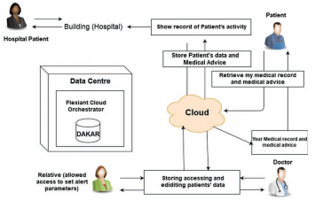
Block Diagram and/or Circuit Diagram

Slide 10
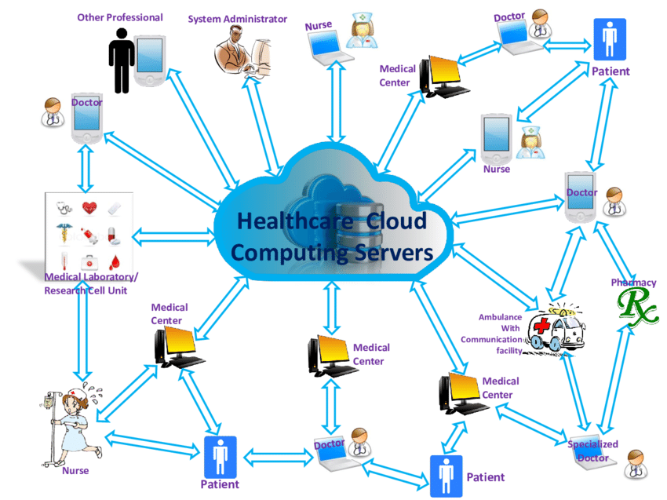
Flow Chart

Slide 11
Effective utilization of the Modern Tool & Cloud
Cloud computing is the delivery of computing services— including servers, storage, databases, networking, software, analytics, and flexible intelligence—over the Internet (“the cloud”) to offer faster innovation, resources, and economies of scale.
Healthcare organizations turn to cloud computing to save on the costs of storing hardware locally. The cloud holds big data sets for EHRs, radiology images and genomic data for clinical drug trials.
Attempting to share EHRs among facilities in various geographic areas without the benefits of cloud storage could delay treatment of patients
Hospitals and physicians are starting to see cloud-based medical records and medical image archiving services coming on line.

Slide 12
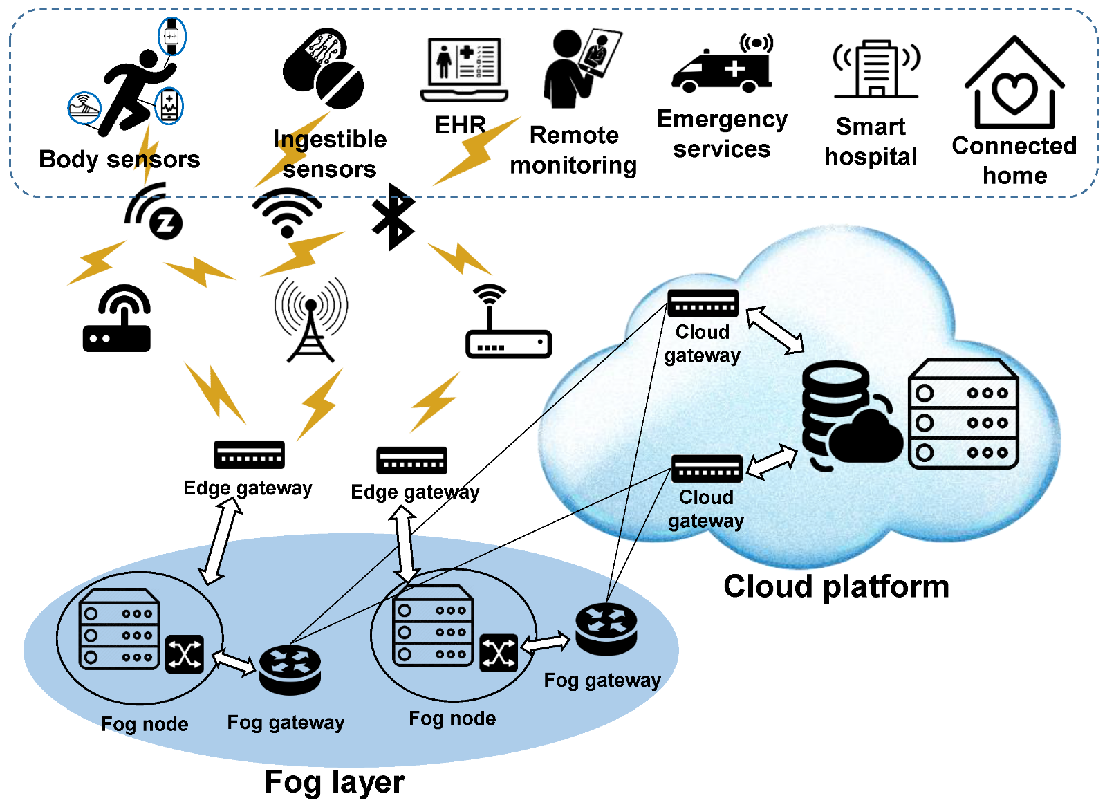
Prototype & Sample Output

Slide 13
ANALYSIS OF RESULTS & DISCUSSIONS
The project evaluate the case of the patients whose medical reports are stored in a cloud. It can be easily accessible to both doctors and patients.
Storing medical records of patients electrically helps to start the treatments fast.
FUTURE WORKS:
Engineers can predict the future health conditions of patients using machine learning. Doctors can give advice and treatment in advance.
This will increase employment opportunities also.
Medication recommendations based on a patient’s health.

Slide 14
References
Rosenthal A, Mork P, Li MH, Stanford J, Koester D, Reynolds P. Cloud computing: a new business paradigm for biomedical information sharing. J Biomed Inform. 2010;43(2):342–53.
Kuo M-H, Kushniruk A, Borycki E. Can cloud computing benefit health services?-a SWOT analysis. Stud Health Technol Inform. 2011;169:379–83.
Regola N, Chawla NV. Storing and using health data in a virtual private cloud. J Med Internet Res. 2013;15(3):e63.

